Slide 1
Charles Darwin

Slide 2
Facts & Figures
Born: 12th February, 1809, in Shrewsbury
Died: April 19th, 1882, in Downe, due to heart problems
In 1831, he set sail on the HMS Beagle for a 5-year voyage around the Earth
He married on January 29th, 1839, to Emma Wedgwood

Slide 3
What is he famous for?
Charles Darwin is most famous for his theory of evolution
He suggested that all species of animal could be descended from ancestral organisms, e.g. Humans & apes descended from the same common ancestor
He also had the idea of ‘natural selection’- when creatures evolve to suit their environment

Slide 4
Obstacles
Charles’ father wanted him to be a doctor, but Charles squirmed at the sight of blood!
His idea did not go down well with the church, as it suggested that humans were not, as the bible tells, created by God.

Slide 5
Forming the idea
The idea of evolution first blossomed in Darwin's mind while he was on the HMS Beagle. He saw how the same species were slightly different in different habitats(like the way Africans have black skin, but they are still humans), and wanted to investigate

Slide 6
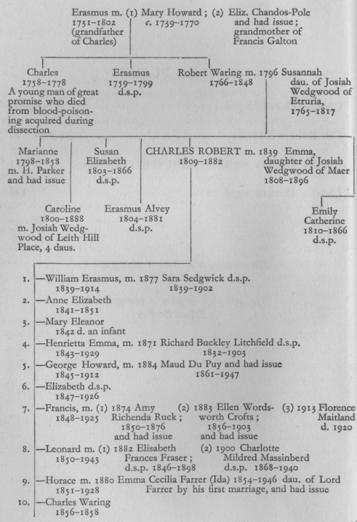
family
Parents: Robert Darwin & Susanna Wedgwood
Wife: Emma Wedgwood
Siblings: Marianne, Caroline, Susan, and Erasmus (all older)

Slide 7
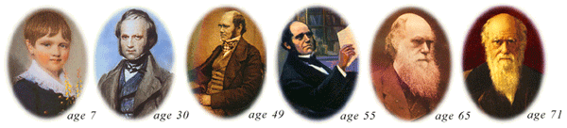
Early life
Darwin attended Shrewsbury free grammar school from 1818-1825
Darwin was baptised on November 1809
His mother died July 1817

